Slide 1
SENTIMENT ANALYSIS OF MOVIE REVIEWS
Presenters
Chhavi Sharma
Prahasan Gadugu
Shubham Basu
Mentor
Manoj Joshi

Slide 2
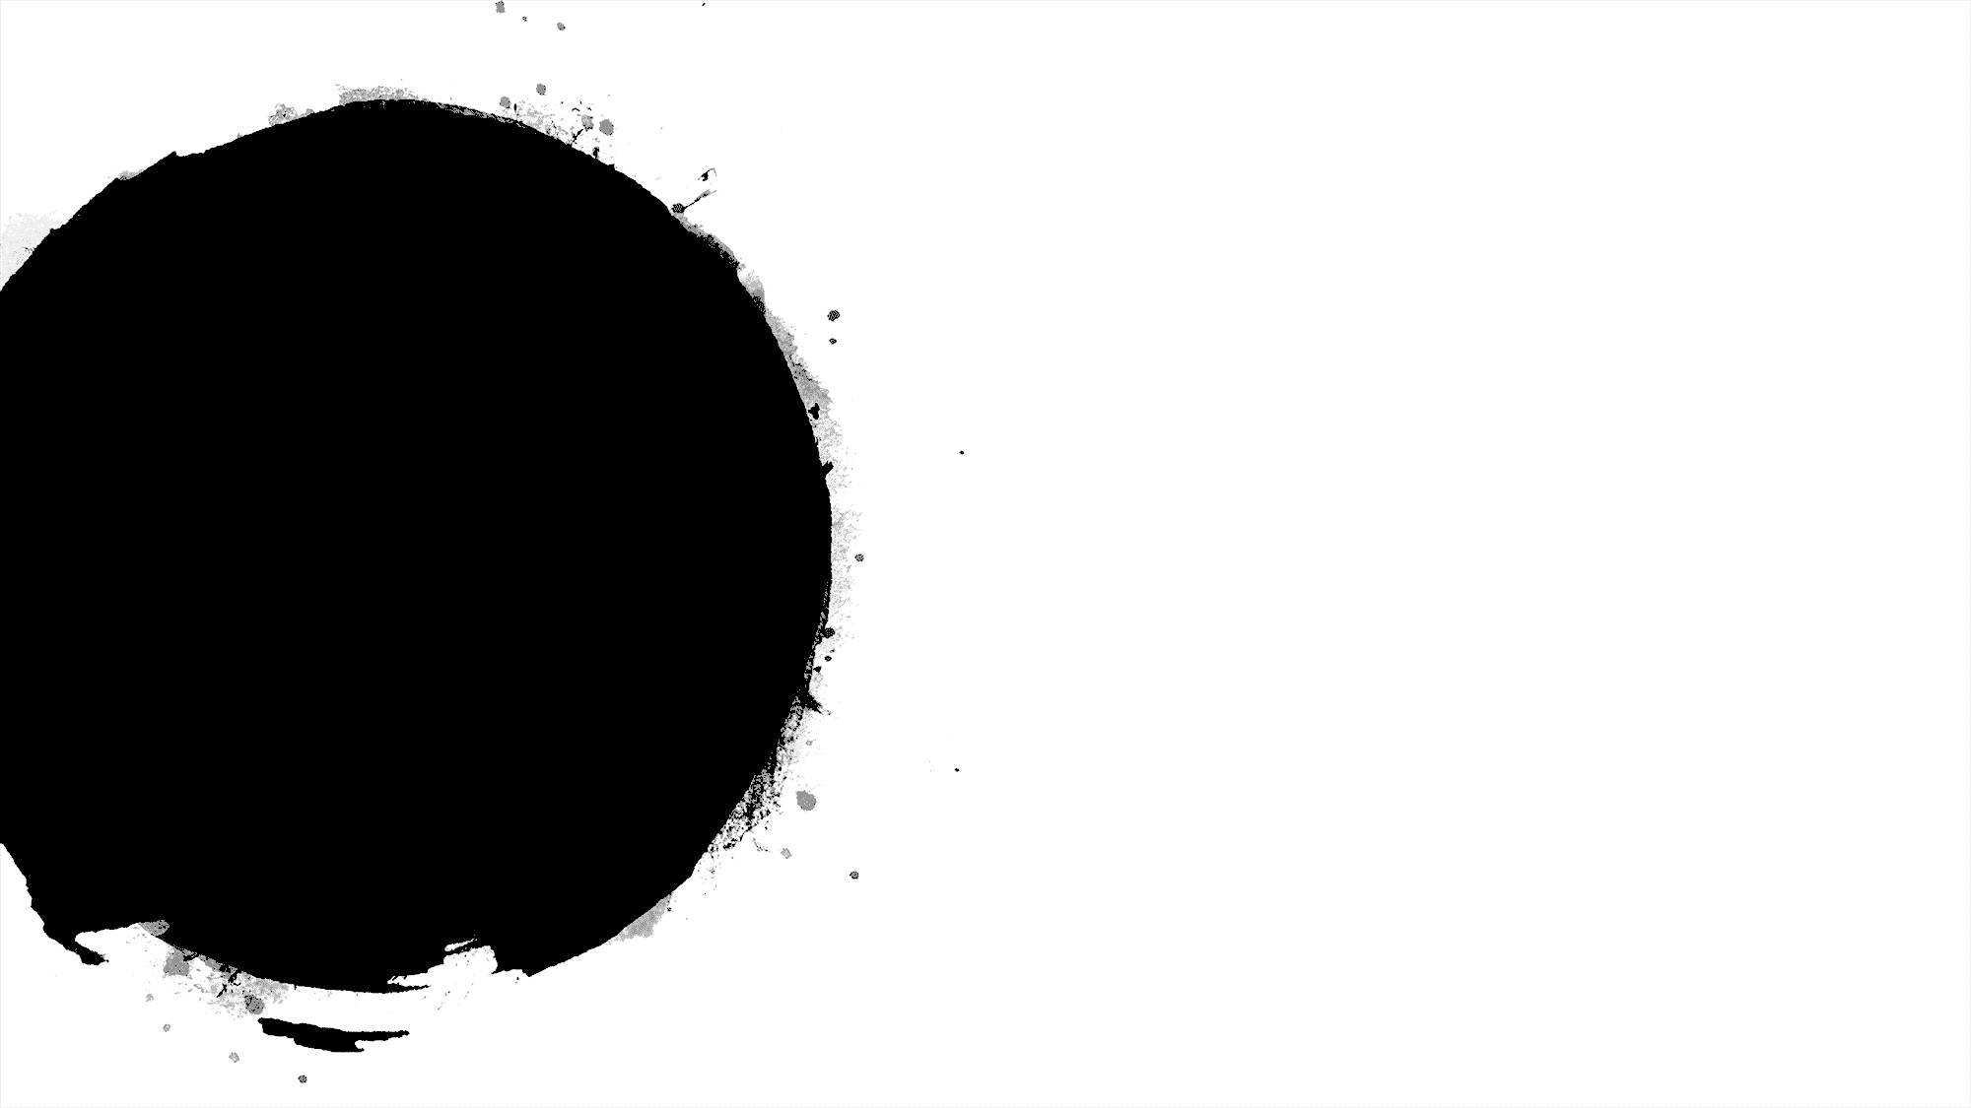
Table of Content
Introduction
Imbalance Data Handling
EDA
Data Cleaning
Feature Extraction
Bag-of-words
TF-IDF
Ngrams (Why not?)
Models
Logistic Regression
KNN
Multinomial Naive Bayes
SVM
Result
Kaggle Test Score
Q & A

Slide 3
Introduction
Sentiment Analysis- determine the underlying sentiment of a textual movie review
Kaggle Dataset- collected from Rotten Tomatoes
Train Dataset:
156,060 data instances
Test Dataset:
66,292 instances
Five sentiment labels:
0- Most negative
1- Somewhat negative
2- Neutral
3- Somewhat positive
4- Most positive

Slide 4

Exploratory Data Analysis
Down-sampled majority class
Calculated average count of phrases per sentence-18.29
Number of phrases- 156060
Number of sentences- 8529
Calculated average word length of phrases- 7.19
Extracted 30 common unigrams, bigrams and trigrams for each sentiment
Data cleaning

Slide 5
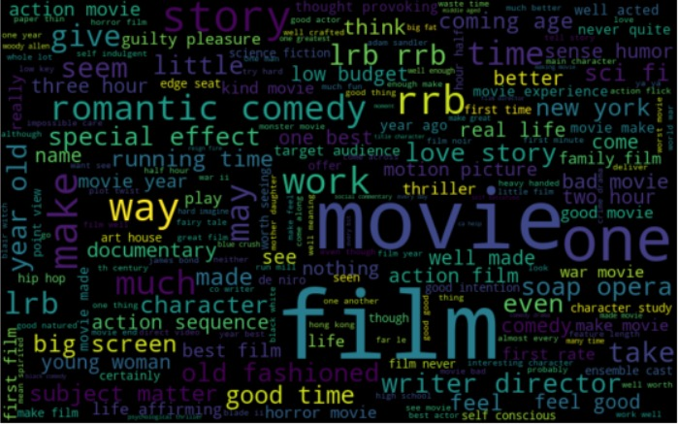
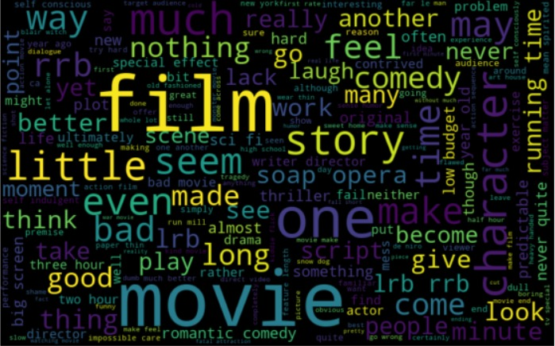
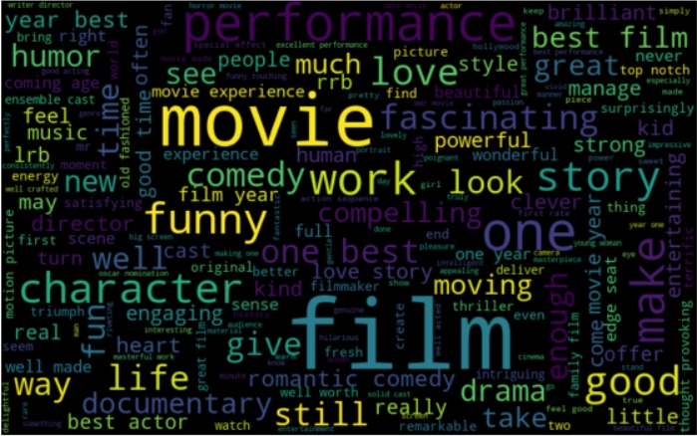
Word Cloud
All Reviews
Negative Reviews
Positive Reviews

Slide 6
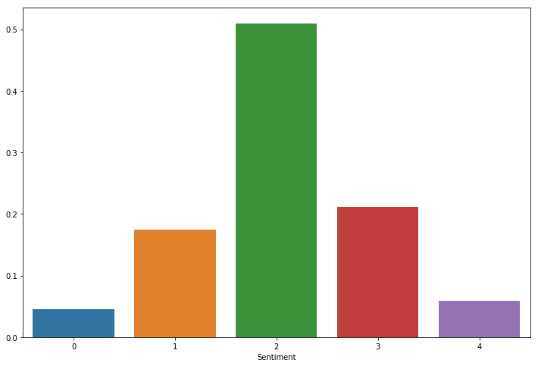
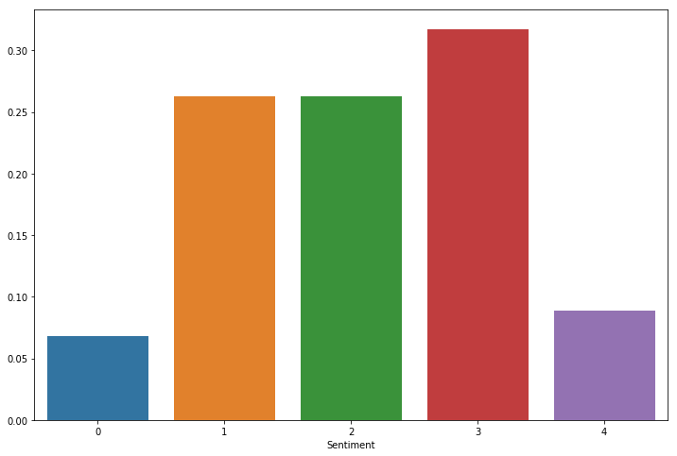
Imbalance Data Handling
Before Down Sampling
After Down Sampling

Slide 7
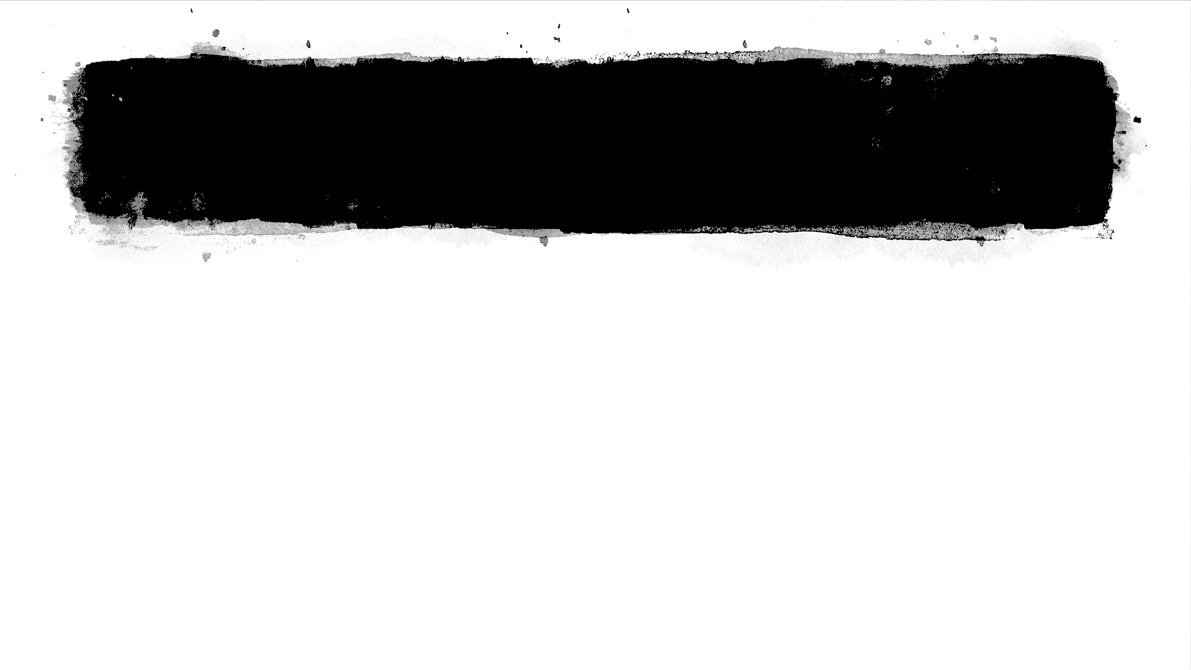
Data Cleaning
Lemmatization
Upper to lowercase transformation
Regex formatting

Slide 8
Feature Extraction
Bag of words
Top 10 most frequent words
TFIDF
Emphasize text semantics
Ngrams-Why not??
MEMORY ERROR!!

Slide 9
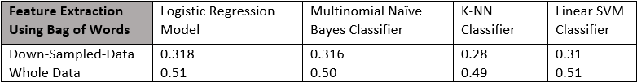
Baseline Models With Bag of words
Implemented models
Logistic Regression
KNN
Multinomial Naive Bayes
SVM
Performed the models on down sampled and original data
Results were much better with the original data

Slide 10
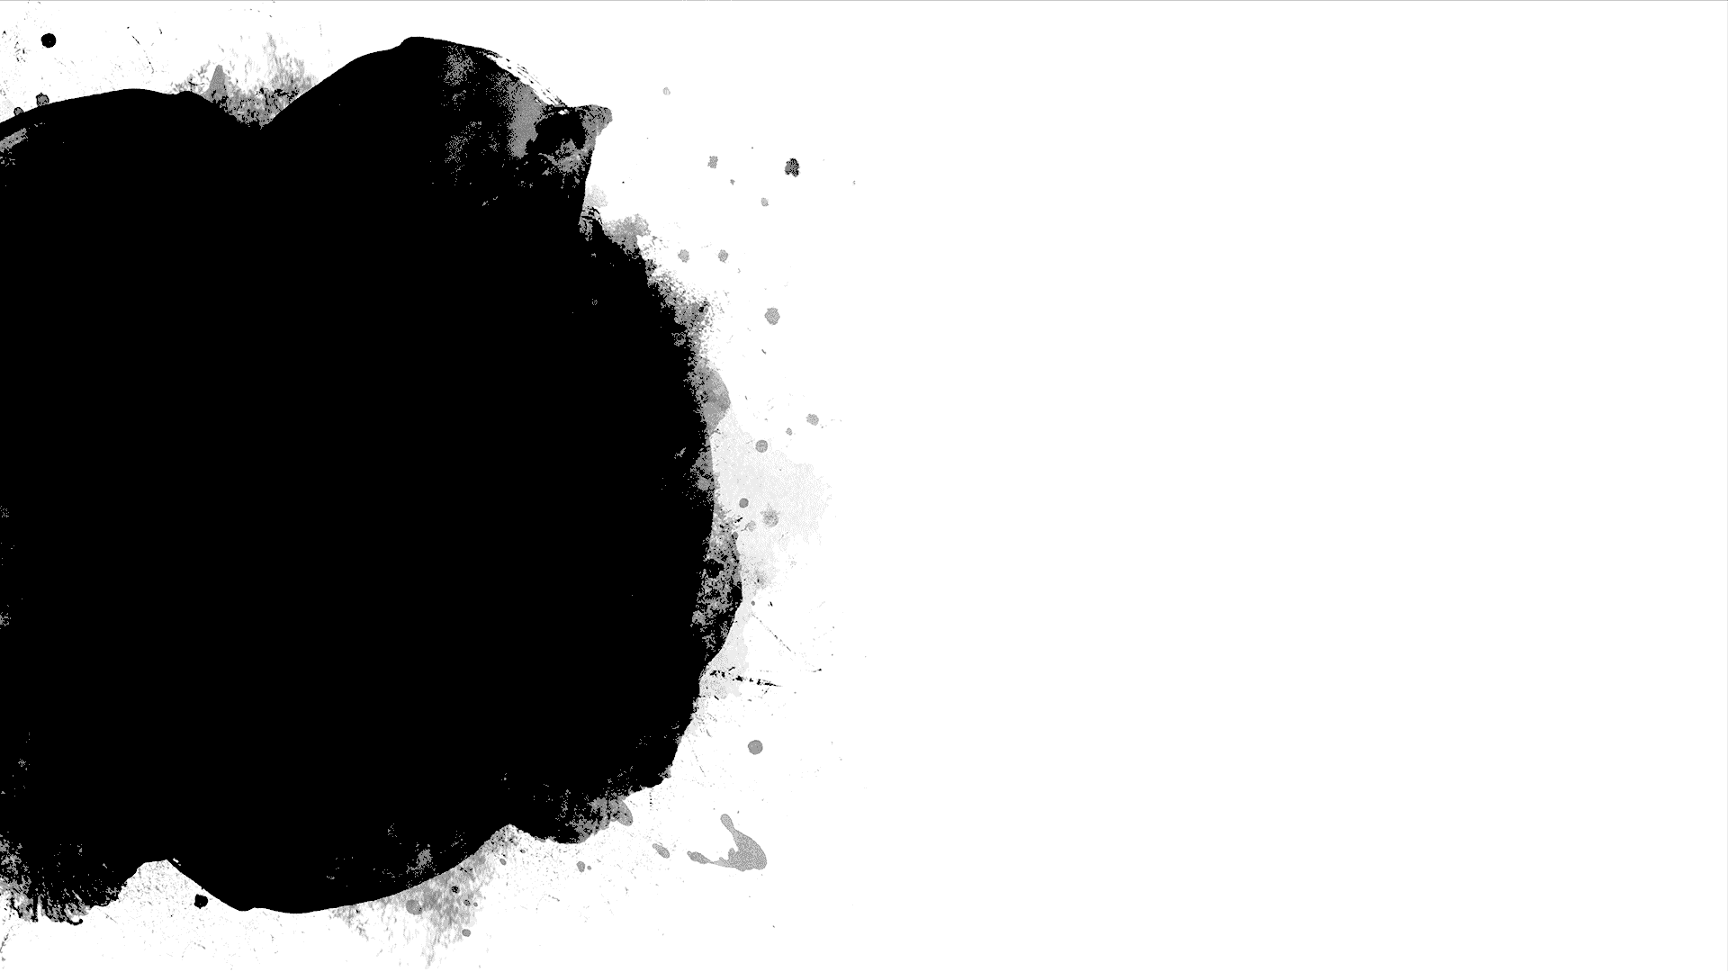
Models Parameterized with TFIDF
Logistic Regression
Multinomial Naïve Bayes
Support Vector Machines

Slide 11
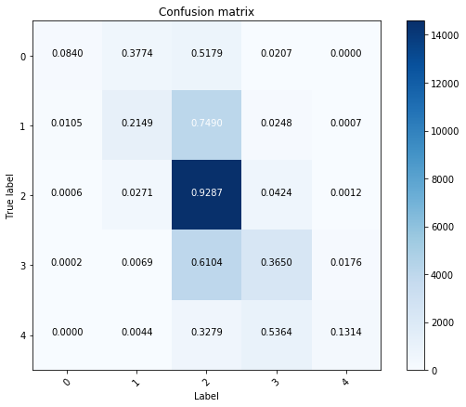
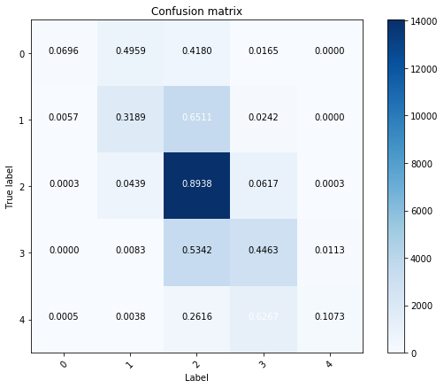
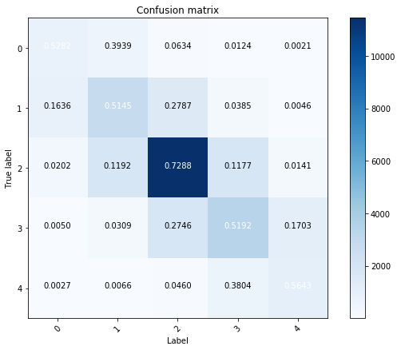
Confusion Matrices
Logistic
Naïve byes
Linear SVM

Slide 12
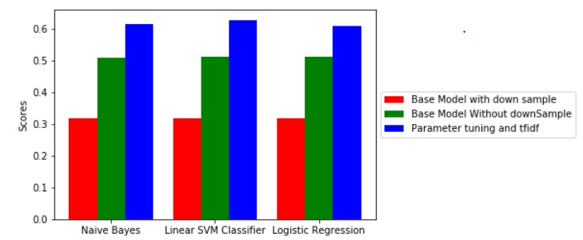
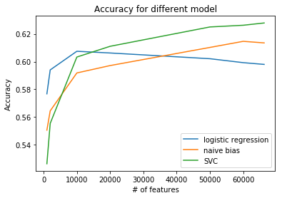
Result
Linear SVC on the original dataset using features extracted from TFIDF gives us the best accuracy
Also we get better results on increasing the number of features

Slide 13
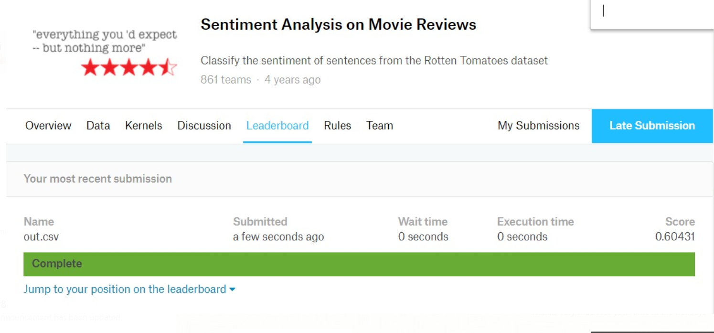
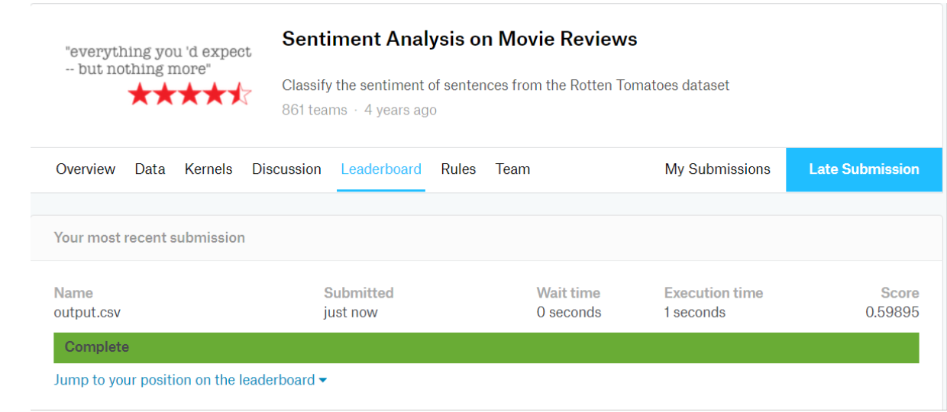
Kaggle Test Submission

Slide 14

Q/A
Thank You

